Slide 1

BUSI 1301 – Business Principles in a Global Economy
Professor: Dr. Joseph L Thompson

Slide 2

Semester Contact Information for Professor Thompson
Professor: Dr. Joseph L Thompson
Preferred Email: jlthompson@bauer.uh.edu
Office Location: 325P MH (Melcher Hall)
Office Hours: Virtual

Slide 3
Class TA
See the syllabus for contact information
The TA is your point of contact for everything course-related
Students must email the TA first
Check the Syllabus Course Calendar and Other Information Before Contacting the TA.

Slide 4
Required Texts
The Syllabus (This is the most important document in the course. Students must keep up to date with the syllabus. If changes need to be made, the professor or your TA will inform students. )
Geringer - International Business (3rd edition) with Connect Plus.
Some topics require additional readings and videos. Those readings and videos will be located in the appropriate topic folder

Slide 5
Recommended Readings
Each student should acquire a copy of the classic book on writing style, The Elements of Style by William Strunk and E.B. White. This book will help all students learn how to write effectively for all writing inside and outside of college.
Anyone involved in global business should be aware of business resources that provide information on industries, companies, markets, and more. Students should also pay close attention to media outlets for up to the minute stories that can have a dramatic impact on international businesses. The following library resources are highly recommended and should be used by each student when conducting research on the international business environment. These sources can be accessed via the UH library by using your CougarNet ID to log in. Click on the link (https://guides.lib.uh.edu/business) for more details about each of these sources.

Slide 6
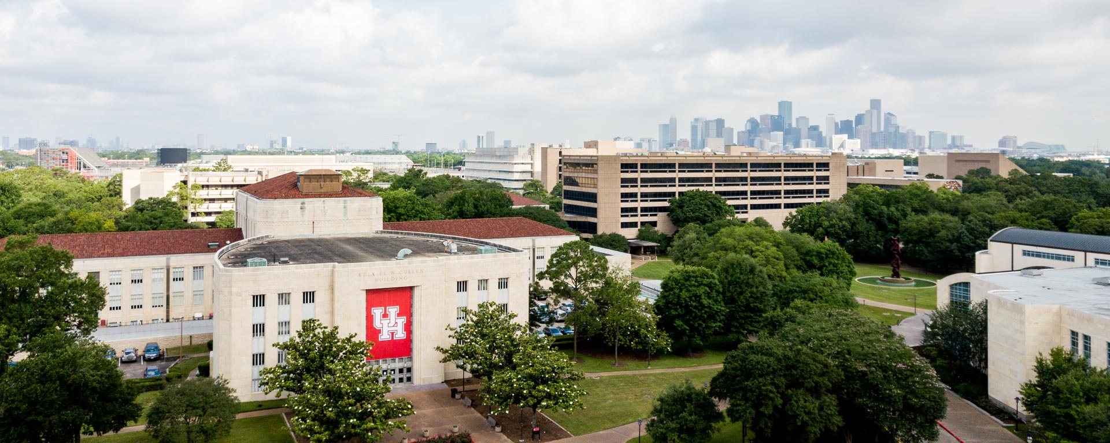

Mental Health
Counseling and Psychological Services
http://www.uh.edu/caps
(713) 743-5454
Let’s Talk Program
(no appointment necessary): http://www.uh.edu/caps/outreach/lets_talk.html

Slide 7

Technology and The Challenging Context of International Business
Click on Musical Notes Throughout Presentation to Hear Lecture
Key Terms:
International Business
Multinational Corporation (MNC)
Multidomestic Company
Global Company
External Forces
Internal Forces
Domestic Environment
Foreign Environment
International Environment
Foreign Direct Investment (FDI)
Lecture Outline:
International Business: An Introduction
International Business and Multinational Corporations
Multidomestic Companies vs. Global Companies
Environmental Forces

Slide 8
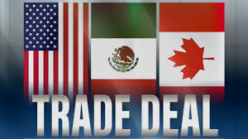

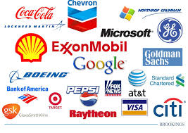

Technology and The Challenging Context of International Business
Click Here
Click on Musical Notes Throughout Presentation to Hear Lecture

Slide 9
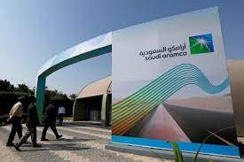
What Is International Business?
Click on Musical Notes Throughout Presentation to Hear Lecture
Simple definition: Business across national borders
Foreign business denotes the operations of a company outside its home or domestic market; many refer to this as business conducted within a foreign country (interchangeable with what we call international businesses)
Any small local business who may purchase materials from, or sell products to, other countries is technically an international business.

Slide 10


International Companies
Click on Musical Notes Throughout Presentation to Hear Lecture
Click Here
International companies (IC) have operations in multiple countries. An international company is involved in exporting and selling its goods and/or services to other nations, but other than exporting (and/or importing, such as purchasing raw materials), has no other investment in these other nations.
An international business is called a Multinational Enterprise (MNE)
Let’s look at how large some of these MNE’s can be

Slide 11

The Largest Companies by Market Cap in 2023 As of June 16, 2023
In 2018, Apple (NASDAQ:AAPL) became the first company to reach a market capitalization of $1 trillion. A few years later, five of the largest companies by market cap have exceeded that number. Although the top spot has changed hands on multiple occasions, Apple has spent the most time there and is currently the most valuable company in the world.
Apple is the largest company in the world, with a market cap of $2.89 trillion.
It's followed by Microsoft ($2.47 trillion), Saudi Aramco ($2.08 trillion), Alphabet ($1.57 trillion), and Amazon ($1.27 trillion).

Slide 12
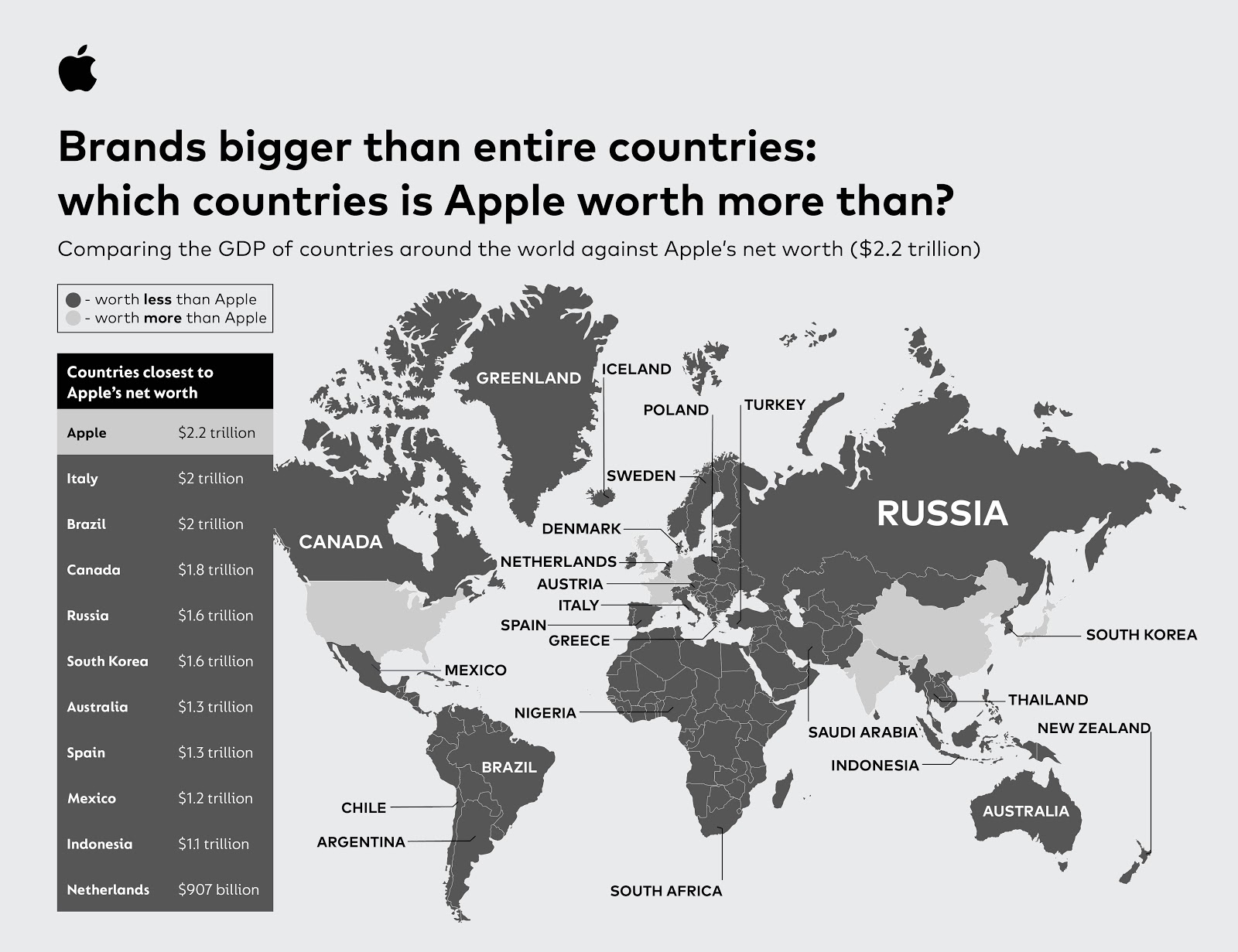
The World’s Most Valuable Company Ranking (By Market Value)
Apple $2.89 trillion.
Microsoft ($2.47 trillion)
Saudi Aramco ($2.08 trillion)
Alphabet (Google) – ($1.57 trillion)
Amazon ($1.27 trillion).
APPLE, AMAZON ARE WEALTHIER THAN 92% OF THE COUNTRIES IN THE WORLD
Seven of the 10 largest companies are in the sector, and five of them have outpaced the S&P 500 over the past five years.
There are only four non-U.S. companies in the top 20: Saudi Arabian Oil, Taiwan Semiconductor Manufacturing, LVMH, and Tencent.

Slide 14
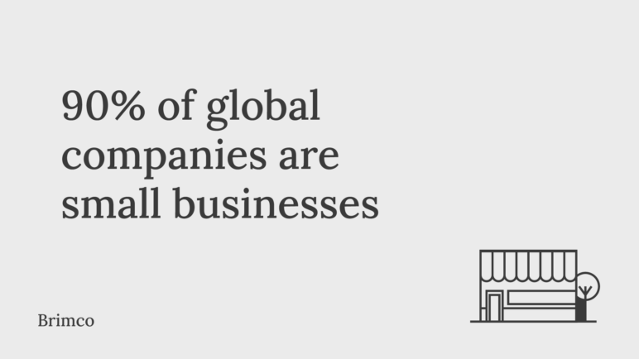
Click on Musical Notes Throughout Presentation to Hear Lecture
Any small local business who may purchase materials from, or sell products to, other countries is technically an international business.

Slide 15
Environmental Forces
Click on Musical Notes Throughout Presentation to Hear Lecture
ENVIRONMENT: ALL THE FORCES INFLUENCING THE LIFE AND DEVELOPMENT OF THE FIRM.
All businesses subject to external and internal forces
Domestic businesses mostly deal with the domestic environment
International businesses have to consider: domestic, foreign, and global environments
Forces operate within each of these environments

Slide 16



EXTERNAL Forces
Click on Musical Notes Throughout Presentation to Hear Lecture
Commonly called Uncontrollable Forces, which are external forces management has no direct control over, although it can exert influence-such as lobbying for a change in a law or heavily promoting a new product that requires a change in cultural attitude.
Management must adapt to changes in uncontrollable environmental variable in order to enhance the prospects for their company’s survival and success.
Recent Uncontrollable Force that dramatically changed International Business, culture, politics: COVID 19

Slide 17

Condoleezza Rice and Amy B. Zegart, Political Risk: How Businesses and Organizations Can Anticipate Global Insecurity (2018).
“Political Risk: Twenty-first century political risk is the probability that a political action could significantly affect a company’s business.”
Social Media and Technology

Slide 18


INTERNAL Forces
Click on Musical Notes Throughout Presentation to Hear Lecture
FORCES that management DOES HAVE SOME CONTROL AND CAN MANAGE IN RESPONSE TO CHANGES IN UNCONTROLLABLE FORCES, such as human resources, finance, production, organizational structures and processes, and marketing are called the CONTROLLABLE FORCES.

Slide 19
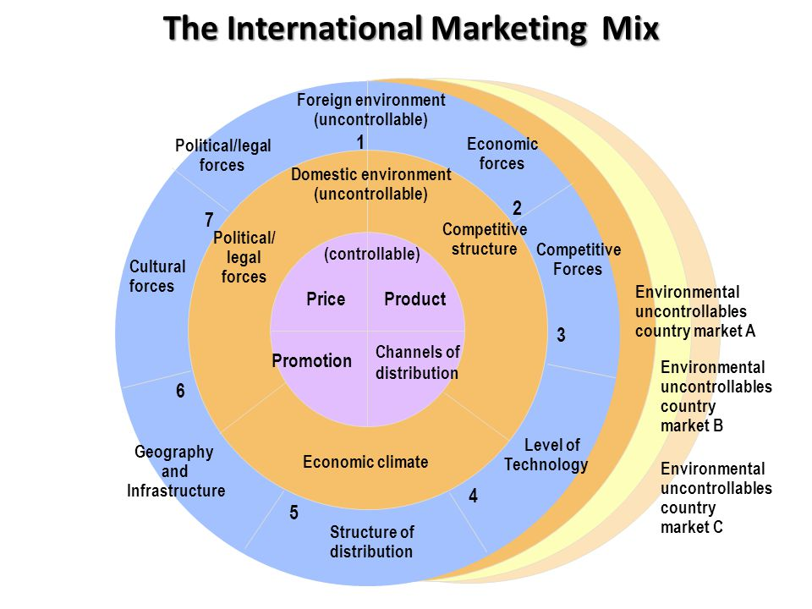

Slide 20
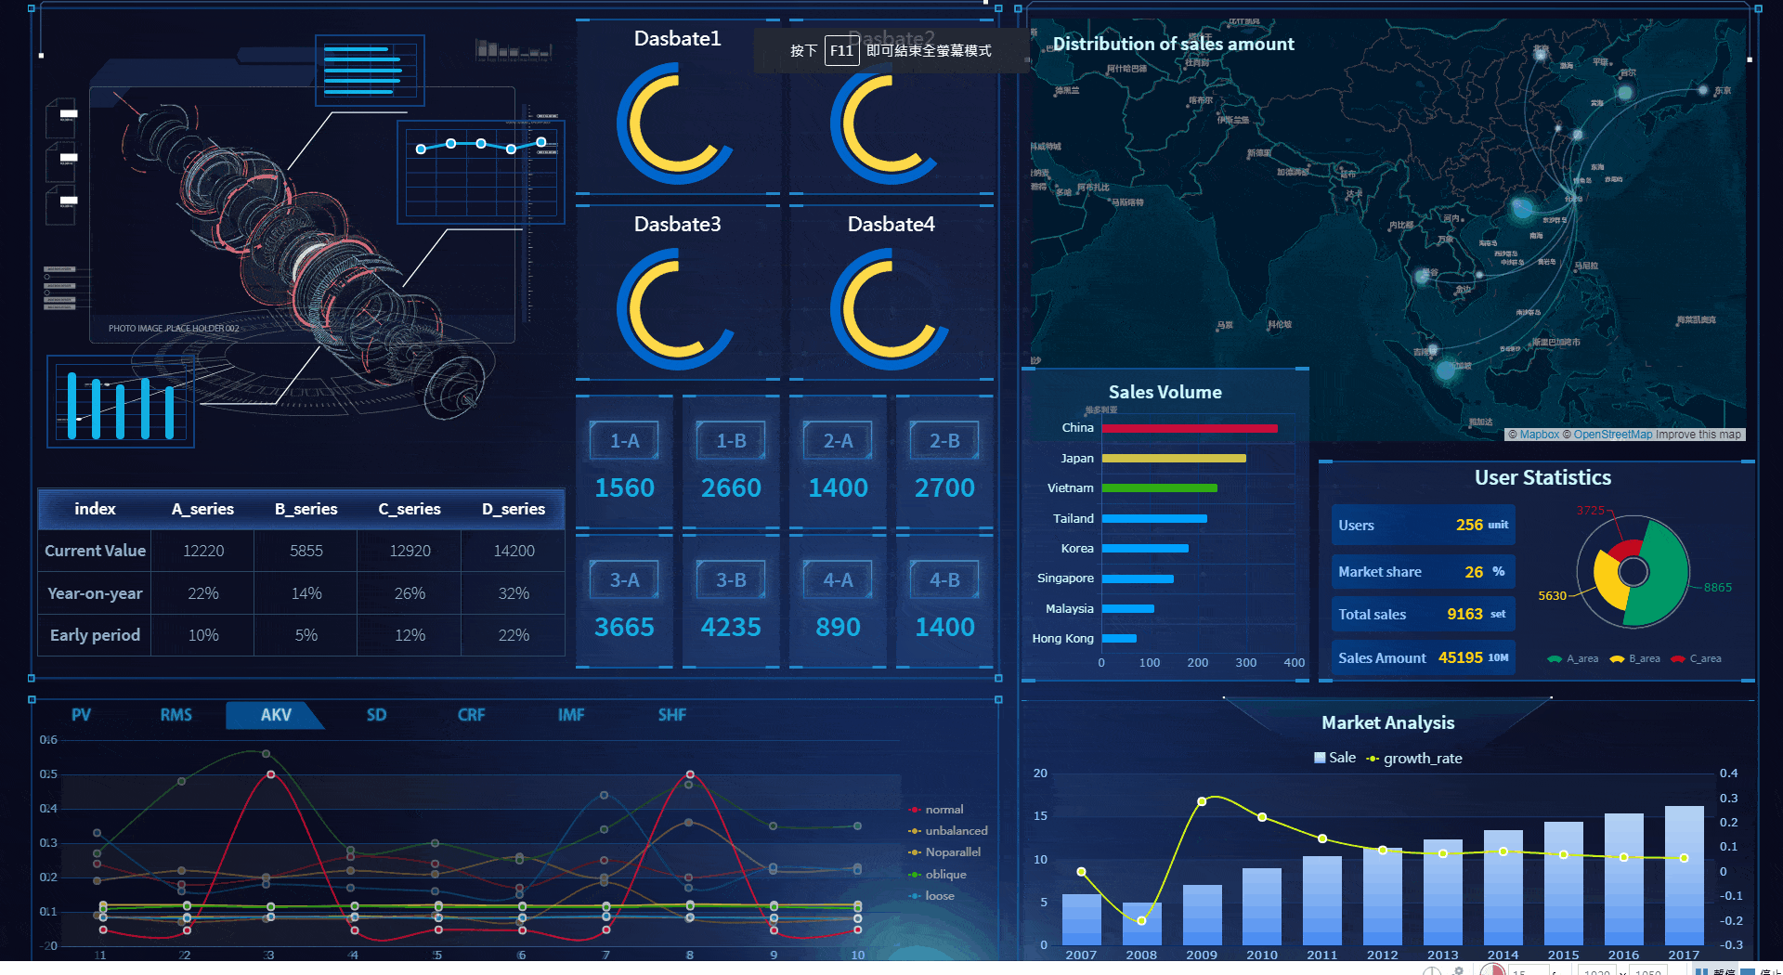
Click on Musical Notes Throughout Presentation to Hear Lecture
The increasing ability of firms to access vast amounts of data on customers and market trends is creating an opportunity often described as “BIG DATA.”
Retailers are using data analytics to improve their market positioning efforts.
Plays a part in literally personalizing the shopping experience.
Here is an example of how Walmart uses Big Data to help personalize the shopping experience (https://youtu.be/42xErufN1e8)

Slide 22

The technology challenges CEOs view as opportunity and threat in a post-Covid economy
Rather than focus on the “right technology,” organizations should aim to deploy the right mix of technology
“In today’s digital age, technology is not only an enabler of business functions but also a critical driver of competitive advantage in many organizations”

